Slide 1
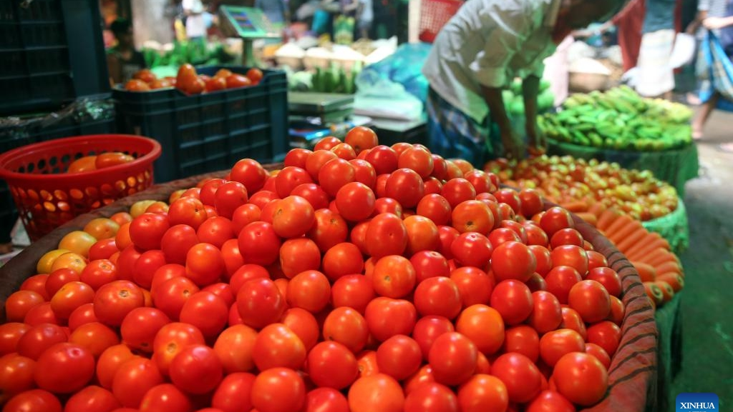
CE902 • Science Fiction Prototype • Professional Practice and Research Methodology
AgriMart BD
A transparent farm-to-home marketplace for Bangladesh
Problem → Solution → Who it helps
Farmers often sell to dealers at very low prices; middlemen capture most of the profit and push up customer prices.
AgriMart BD connects farmers directly with customers via an app, with listings, regional sorting, ratings, and trusted delivery and payment.
Stakeholders: Farmers (sell + fair profit), Customers (fresh produce + transparency), Delivery/quality team (logistics), Local advertisers (reach buyers).
Name: Hrithik Majumdar Shibu | Registration No: 2501488 | Date: 20th March 2026
Notes:
[Sources] - Background photo (Dhaka fruit & vegetable market, Xinhua via Global Times): https://www.globaltimes.cn/page/202410/1321635.shtml - Problem/solution framing and stakeholder objectives from BRS: (uploaded) BRS.docx. - Slide requirements (2-slide deck, include µSFP + business opportunity): (uploaded) Science Fiction Prototype - Assignment brief.docx. [/Sources]

Slide 2
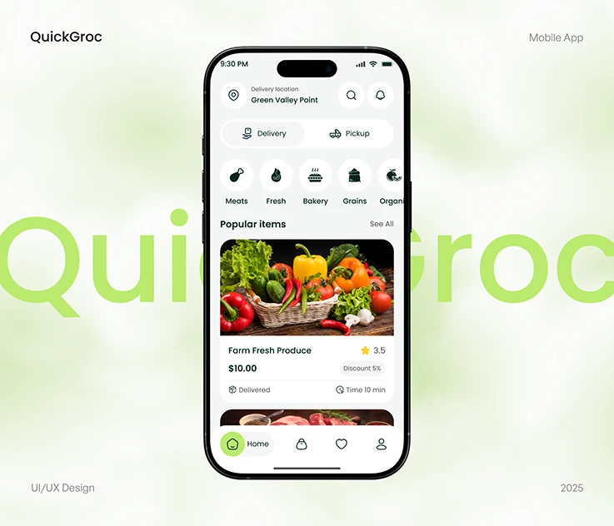
µSFP (Micro Science-Fiction Prototype)
Product feel (mobile app proposed)
A farmer in rural Bangladesh opens AgriMart BD, scans today’s harvest, and posts verified prices.
A city family orders with one tap; the app routes a local courier and pays the farmer instantly after delivery.
Middlemen profits shrink—trust grows, waste drops, and both sides win.
Business opportunities
Commission on transactions (sustainable revenue model).
Regional expansion: onboarding/training programs for non‑tech farmers.
Logistics + quality-check partnerships (last‑mile delivery network).
Local advertising & promoted listings for agri-inputs, tools, seeds, etc.
Data insights (price trends, demand forecasting) offered to partners/government.
Notes:
[Sources] - µSFP and business opportunity points derived from BRS (problem statement, objectives, revenue model): (uploaded) BRS.docx. - Assignment requirements for µSFP + 2-slide presentation: (uploaded) Science Fiction Prototype - Assignment brief.docx. - App UI mock image used as illustrative visual (Behance project image): https://www.behance.net/gallery/222519197/Grocery-Delivery-Mobile-App [/Sources]

